Slide 1
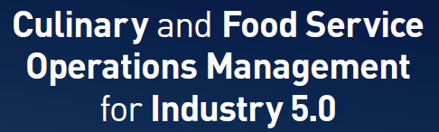
Chapter 5
Enhanced Food Service Operations in Industry 5.0

Slide 2
Chapter 5
Explores the developments of industrialisation and the use of new technologies within culinary and food service operations
This chapter covers:
The historical progression of industrial revolutions and their impact on food service operations
Unique features and technologies that distinguish Industry 4.0 and 5.0.
Value of effective digital marketing strategies through social media and influencers for brand promotion
The importance of the application of big data for marketing insights

Slide 3
Introduction to Industry 5.0
Industry 5.0 marks a significant transition in the way businesses operate, placing a strong emphasis on human-machine collaboration, sustainability and people
Industry 5.0 blends cutting-edge technologies such as:
  Artificial intelligence (AI)
  big data
  machine learning
  robotics
  with human intuition, creativity, and cultural understanding.

Slide 4
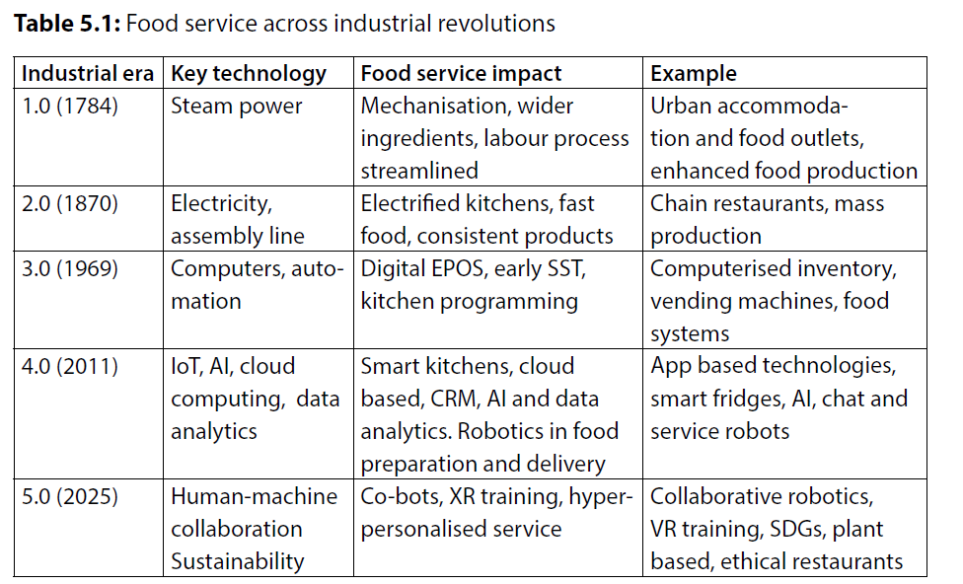
Evolution of food service operations 5.0

Slide 5
Key technologies of Industry 5.0
Rapid evolution of technology across many industries, and the adoption of digital systems from Industry 4.0 has shifted to the emergence of Industry 5.0
Extending beyond the digital automation focus through reintroducing the value of human collaboration alongside intelligent systems.
A significant amount of interconnected, smart, and adaptive systems designed to enhance:
  Productivity
  Personalisation
  Customer experiences,
  Improve operational sustainability
  Prioritising human-centric, sustainable, and resilient approaches

Slide 6
Key technologies of Industry 5.0 in food service
In the food service sector, these are the technologies that:
Manage transactions (EPOS)
Streamline kitchen operations (smart ovens, digital ordering systems)
Enable customer interaction (AI and SST)
Facilitate service delivery (robotics)
Enhance decision-making through data analytics (big data)
Additionally, immersive technologies like VR, AR, and eXtended reality (XR) are being incorporated to:
  enrich customer engagement and experiences
  support employee training and development
  reshape the current operational landscape

Slide 7
Robotics
Food delivery, table service, and kitchen assistance
Rapidly adopted in fast-casual and Quick-Service Restaurants (QSRs)
“Servi”, “Bella”, “Pepper” and “Temi” can navigate dining areas, deliver meals, and clear tables
Work collaboratively with human staff
Integrated collaboration enables precision in preparation and consistency
A new era of collaboration between humans and machines

Slide 8
Robotics (cont’d)
Can perform high-precision tasks consistently, improving food preparation quality and reducing errors
Robotic arms have been programmed to cook and assemble meals
Automated fryers and grills can maintain optimal cooking conditions
Consistency is beneficial for large-scale operations
Full-scale restaurant operation implemented in the USA powered completely by robots

Slide 9
Robotics (cont’d)
Robots are increasingly being used in customer-facing roles
Deliver food to tables, assist with menu selections, and handle payments, which offers the possibilities of enhancing the dining experience and reducing wait times
Robotic servers, equipped with voice recognition and AI, can handle basic customer inquiries, directing human staff’s attention toward more complex requests

Slide 10
Human Robot Collaboration
Collaboration improves efficiency while maintaining a human touch in the customer experience
Human-robot collaboration aids labour shortages
Robots can fill gaps in staffing
Successful human-robotic collaboration requires thoughtful integration and training
Human-robot collaboration in food service holds the potential to elevate the industry combining robotic precision with human hospitality, creating an efficient, high-quality dining experience

Slide 11
Strategies and barriers for technology adoption
The contemporary food service industry has undergone significant digital transformations with increased adoption of emerging technologies of:
  Self-service kiosks (SSK)
  Mobile ordering systems
  Service robots
  AI-driven analytics
  Smart kitchen equipment
Innovations aim to enhance operational efficiency, improve customer experience and increase profitability

Slide 12
Strategies for technology adoption
A successful technology adoption strategy in food service operations requires clear alignment between organisational goals, customer expectations, and technological capabilities
A framework to consider in the process of adoption is the Technology-Organisation-Environment (TOE) framework

Slide 13
Strategies for technology adoption (cont’d)
Operators must assess the technological benefits
Evaluate organisational readiness
Respond to environmental pressures
Employee training and involvement are vital
Involving staff and providing adequate training increases acceptance and promotes a culture of innovation
Food service operations increasingly rely on big data and analytics tools to inform technology investments
Analysing customer preferences, transaction patterns, and operational bottlenecks, managers can prioritise technological solutions with the highest potential for return on investment and customer impact

Slide 14
Barriers to technology adoption
The most prominent challenge is the financial cost
Employee resistance can represent a significant barrier
Customer acceptance is critical
Operational complexity presents a further barrier
Concerns over data privacy and security

Slide 15
Marketing and digital transformations:
Online and offline
Crucial due to the highly competitive nature of the business
Traditionally reliant on personal selling, brochures, and word-of-mouth.
The need to explore both online and offline marketing strategies
Online marketing utilises campaigns through channels such are websites, social media and advert driven ‘pop ups’ within web-based systems
Offline marketing uses traditional face to face marketing though paper-based media, magazines, billboards and television advertising

Slide 16
The Marketing Mix (7Ps)
The Marketing Mix provides a foundational framework for analysing marketing strategies:
  Product
  Price
  Place
  Promotion
  People
  Process
  Physical evidence

Slide 17
Offline marketing
Relationship marketing focuses on long-term customer engagement
Customer retention through loyalty programs, personalised communication, and consistent service quality
Service encounters are personal and experiences subjective to the individuals
Building relationships is particularly significant
Offline marketing remains valuable due to its personal and experiential nature
The use of print via magazines, brochures, and newspapers have traditionally advertised food services
Print reach has declined - influential among certain demographics and for niche marketing

Slide 18
Digital (online) marketing
Digital marketing leverages online platforms.
Marketing in the food service industry has undergone a digital revolution.
Social media, platforms such as Instagram, Facebook, X, and TikTok, enable direct engagement with customers.
Influencer marketing leverages popular figures to reach target demographics authentically, while review sites like TripAdvisor, Google and Yelp shape reputation and customer decision-making.
Paid digital advertising, Search Engine Optimisation (SEO), and email marketing campaigns target potential customers efficiently.

Slide 19
Key approaches include:
Visual storytelling: High-quality images, reels, and short videos capturing food preparation, plating, and customer reactions.
Campaigns and promotions: Announcing offers, discounts, and new product launches via targeted posts.
Interactive engagement: Polls, contests, live question and answer sessions, and user-generated challenges.

Slide 20
Influencer marketing
Influencers are social media users with significant follower bases and perceived expertise in food, lifestyle, or local experiences.
Collaborating with micro (10k–100k followers) or macro influencers (>100k followers) enhances brand credibility and visibility.
Influencers can promote the product, service and ultimately support business growth and profitability.

Slide 21
Integrating online and offline marketing
An effective marketing strategy integrates both online and offline channels.
Multichannel campaigns, consistent branding, and cross-promotions ensure message cohesion.
Integrated marketing maximises reach and reinforces brand messages.
The integration of digital marketing strategies with staff training and app-based systems creates synergy in food service operations.
Cross-functional collaboration between marketing and operations teams ensures promotional campaigns align with service capabilities and customer expectations.
Holistic approach enhances the brand experience and operational agility, positioning food service operators competitively in a digital marketplace.

Slide 22
Leveraging big data for marketing
Big data refers to extremely large, complex digital data sets generated at high velocity from diverse sources.
Originating from advancements in computing, storage, and connectivity, big data is characterised by the three Vs:
  Volume: Massive amounts of data from multiple sources
  Velocity: Data generated and processed at high speeds data from multiple sources
  Variety: Different formats (text, images, video, transaction records, sensor data).

Slide 23
Summary
The Industry is evolving and culinary and food service businesses need to adapt to change
Technology is having significant impact
Humans needs to collaborate with technology
There needs to be a focus on adoption and be aware of the key strategies and barriers
Marketing is changing and both online and offline should be considered

Slide 24
Revision Questions
What examples of change has happened throughout the different industrial eras?
What technological adoptions has been made within businesses?
What examples of strategies and barriers can you suggest towards technological adoption?
Give some examples of online and offline marketing.

Slide 25
End of Chapter 5 presentation

Slide 26
Culinary and Food Service Operations Management for Industry 5.0
David Graham is an Associate Head at Sheffield Hallam University within Sheffield Business School, a visiting Research Fellow at the University of Zululand, South Africa and Principal Fellow of Higher Education Academy.
Ewen Crilley is a Senior Lecturer at Sheffield Hallam University and Course Leader for UG and PG Tourism, Hospitality, Culinary and Aviation.
Peter Cox worked in the hotel and contract catering for large international companies. He was a Senior Lecturer at Leeds Beckett University specialising in quality and hospitality operations management.
John Cousins is a consultant, educator, and the author of a range of food and beverage management and service publications, He has been conferred at Culinary Arts Laureate and is Director of the Food and Beverage Training Company.
© 2026 David Graham et al. Culinary and Food Service Operations Management for Industry 5.0. Goodfellow Publishers

